Slide 1

Covid Cases Tracker using COVID-19 Coronavirus Statistics API using IBM Cloud
done by
Sai kiran, Sannith Raj, Sindhuja, Nithin, Raghu Ram

Slide 2
INDEX:
1. introduction
2. flask and API
3. advantages and disadvantages of API
4. result
5. conclusion

Slide 3

INTRODUCTION:
Everybody in our society is eager to know the latest news about the covid-19 pandemic. The numbers of newly infected persons, death rates and other epidemiological facts. The alarming economic consequences are discussed based on indicators referring to unemployment, losses in production output and GDP and others, at global, country and micro levels. Insufficient information about the social consequences of loss of work, Closed school, the overloaded health system causes speculations
Visualizing Covid-19 statistics helps understand the raise or
Fall in a easy way.

Slide 4
What is an API and how does it works?
API stands for application programming interface. An API is a software intermediary that allows two applications to talk each other. In other words, an API is the messenger that delivers your request to the provider that you are requesting it from and then delivers the response back to you.
what is flask?
Flask is a micro web framework written in python. It allows us to build up web-applications. It was developed by Armin Ronacher.

Slide 5
Advantages and disadvantages of API
advantages:
API allows content to be embedded from any site or application more easily. This gives us much better information and an integrated user experience
through API any user or company can customize the content and services that they use the most

Slide 6
disadvantages:
implementing and providing API capabilities can be costly in terms of development times
ongoing maintenance requirements
providing support

Slide 7
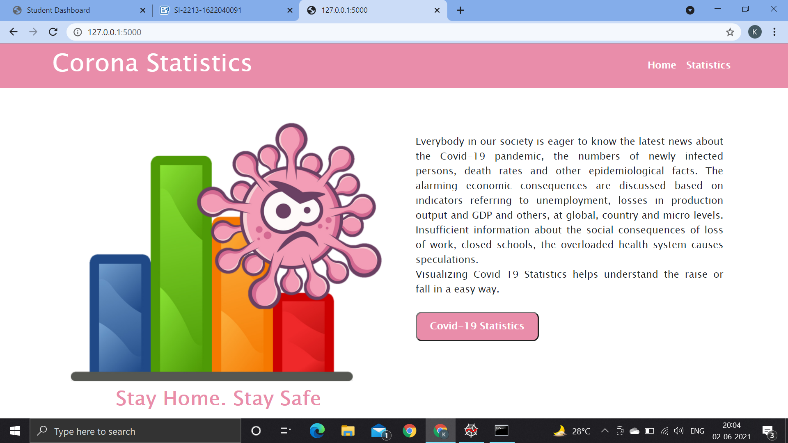

Slide 8
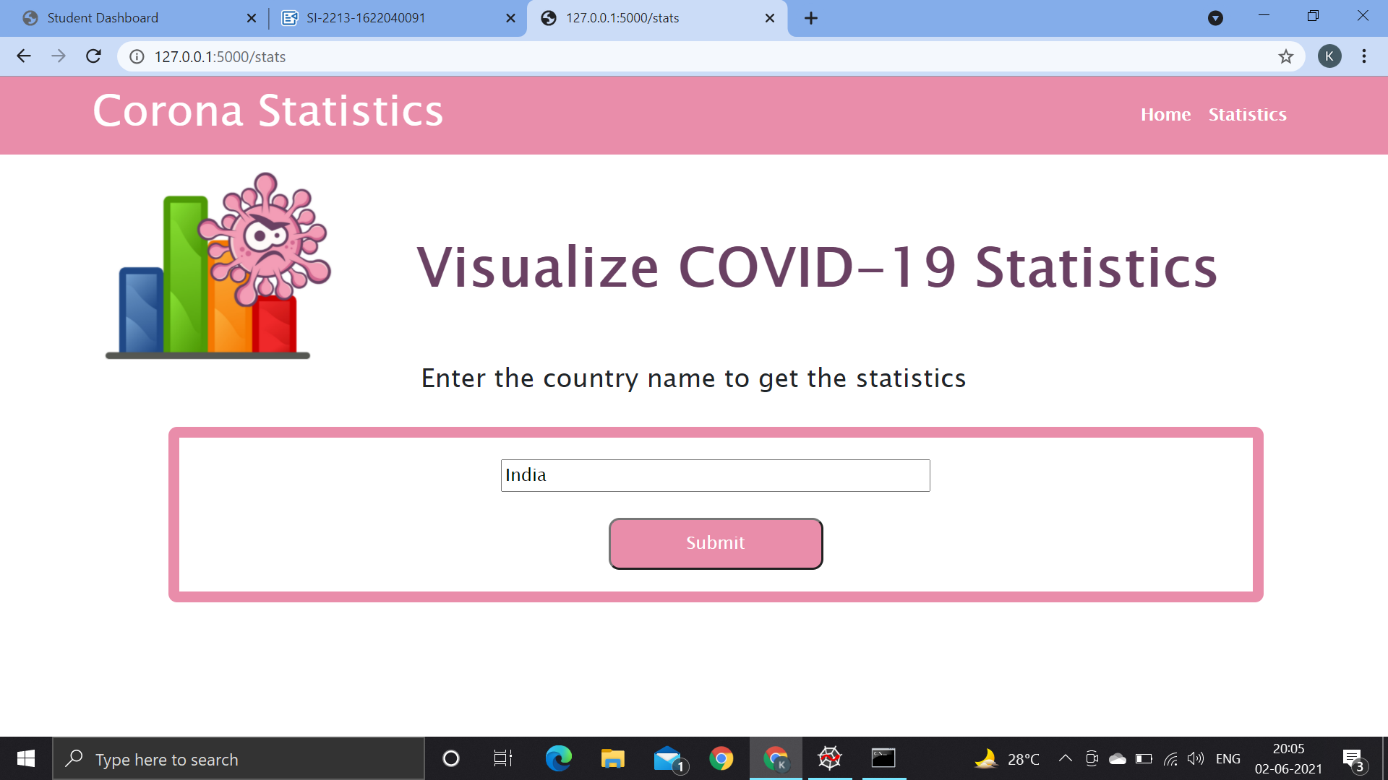

Slide 9
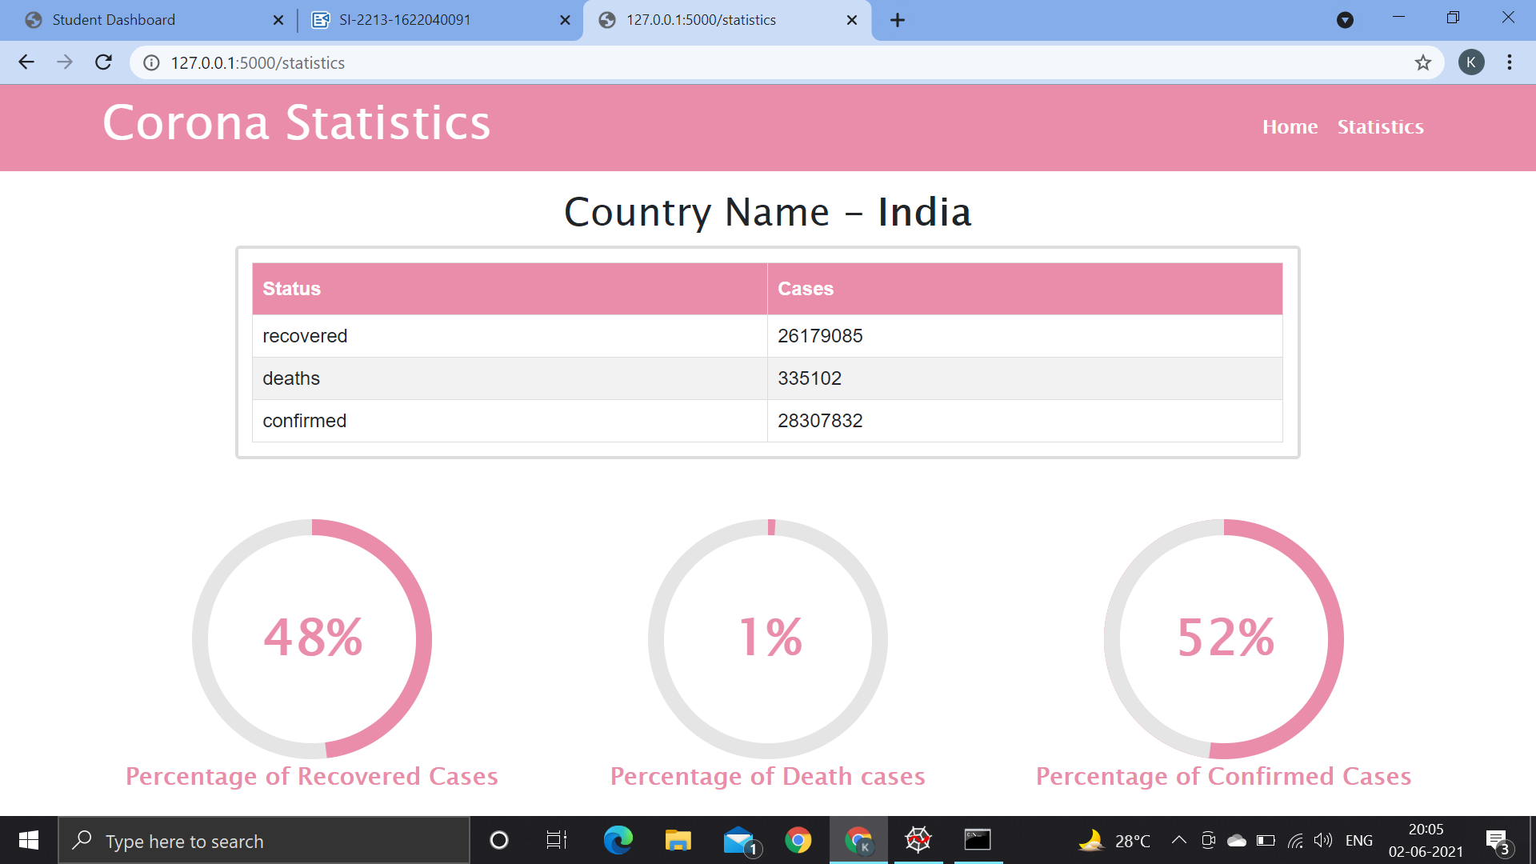

Slide 10
Conclusion:
we have taken a basic API. It gives us the covid-19 statistics of the respected country. In this case, When we give the input as “India” it gives us the total confirmed cases, recovered cases and total deaths of the country

Slide 11
Thank you
project by EEE-02
Sannith Raj – 19R11A0215
Sai Kiran – 19R11A0219
Sindhuja – 19R11A0220
Nithin – 19R11A0222
Raghu ram – 19R11A0226

